Slide 1

Cisco NaaS study: IT pros are interested but wary by Michael Cooney -Network World Blog, 11/3/21, LINK
By Ryan J. Skelly, IT 609 Current Event #2

Slide 2
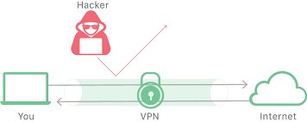
Who, What, When, Where, and Why??
Cisco, 1534 IT Professionals, Corporations,
Network as a Service, and other aaS models
Present day and the future
Enterprises, Companies
Reduce network complexity, security,
keep up with growing infrastructure needs

Slide 3
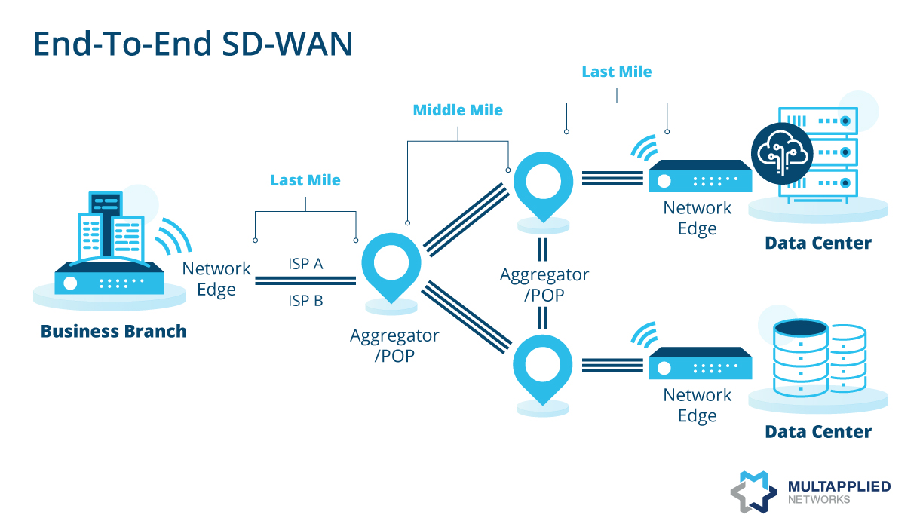
Key Points from Study
2021 Top Networking Challenges
- Responding to disruptions(45%)
- Accommodating new business needs(40%)
35% are upgrading to NaaS for the latest networking technologies
49% desired multicloud access
40% of large-enterprise IT budgets will be redistributed due to adoption of as-a-service bundles
50% of data-center infrastructure will be transitioned to the as-a-service model by 2024

Slide 4

How this relates to IT609
Additive to the other aaS Cloud offerings(PaaS, IaaS, SaaS)
Can be virtualized similarly to IaC
WAN specification

Slide 5
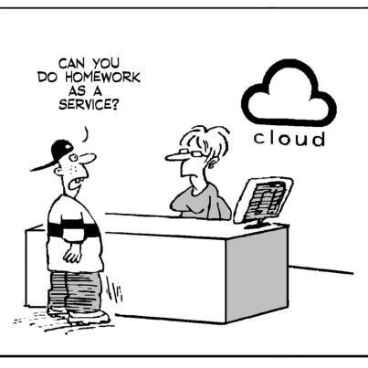
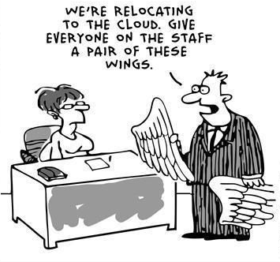
Thanks For Watching!!

